Slide 1
Level 4/5 Group 15
Concept Pitch

Slide 2
Brief
For 2 players
Physics based
Adversarial
(i.e. “...characterised by conflict or opposition” – Oxford Dictionary)
On a single device
(i.e. No hidden information)

Slide 3
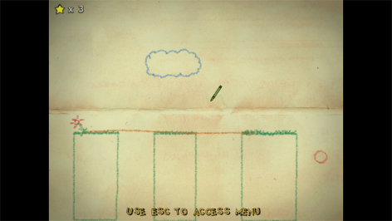
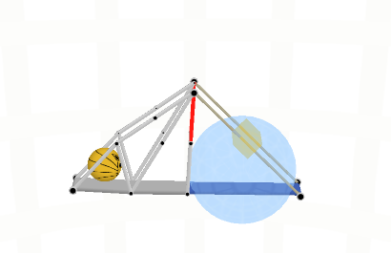
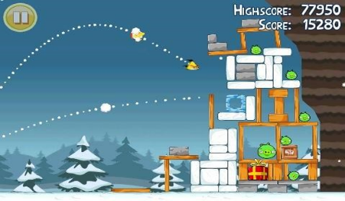
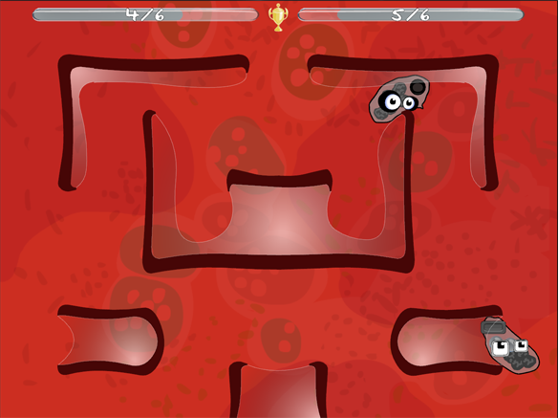
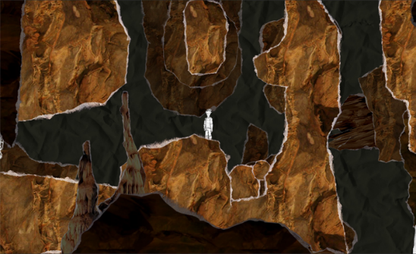
Research – Other Games

Slide 4
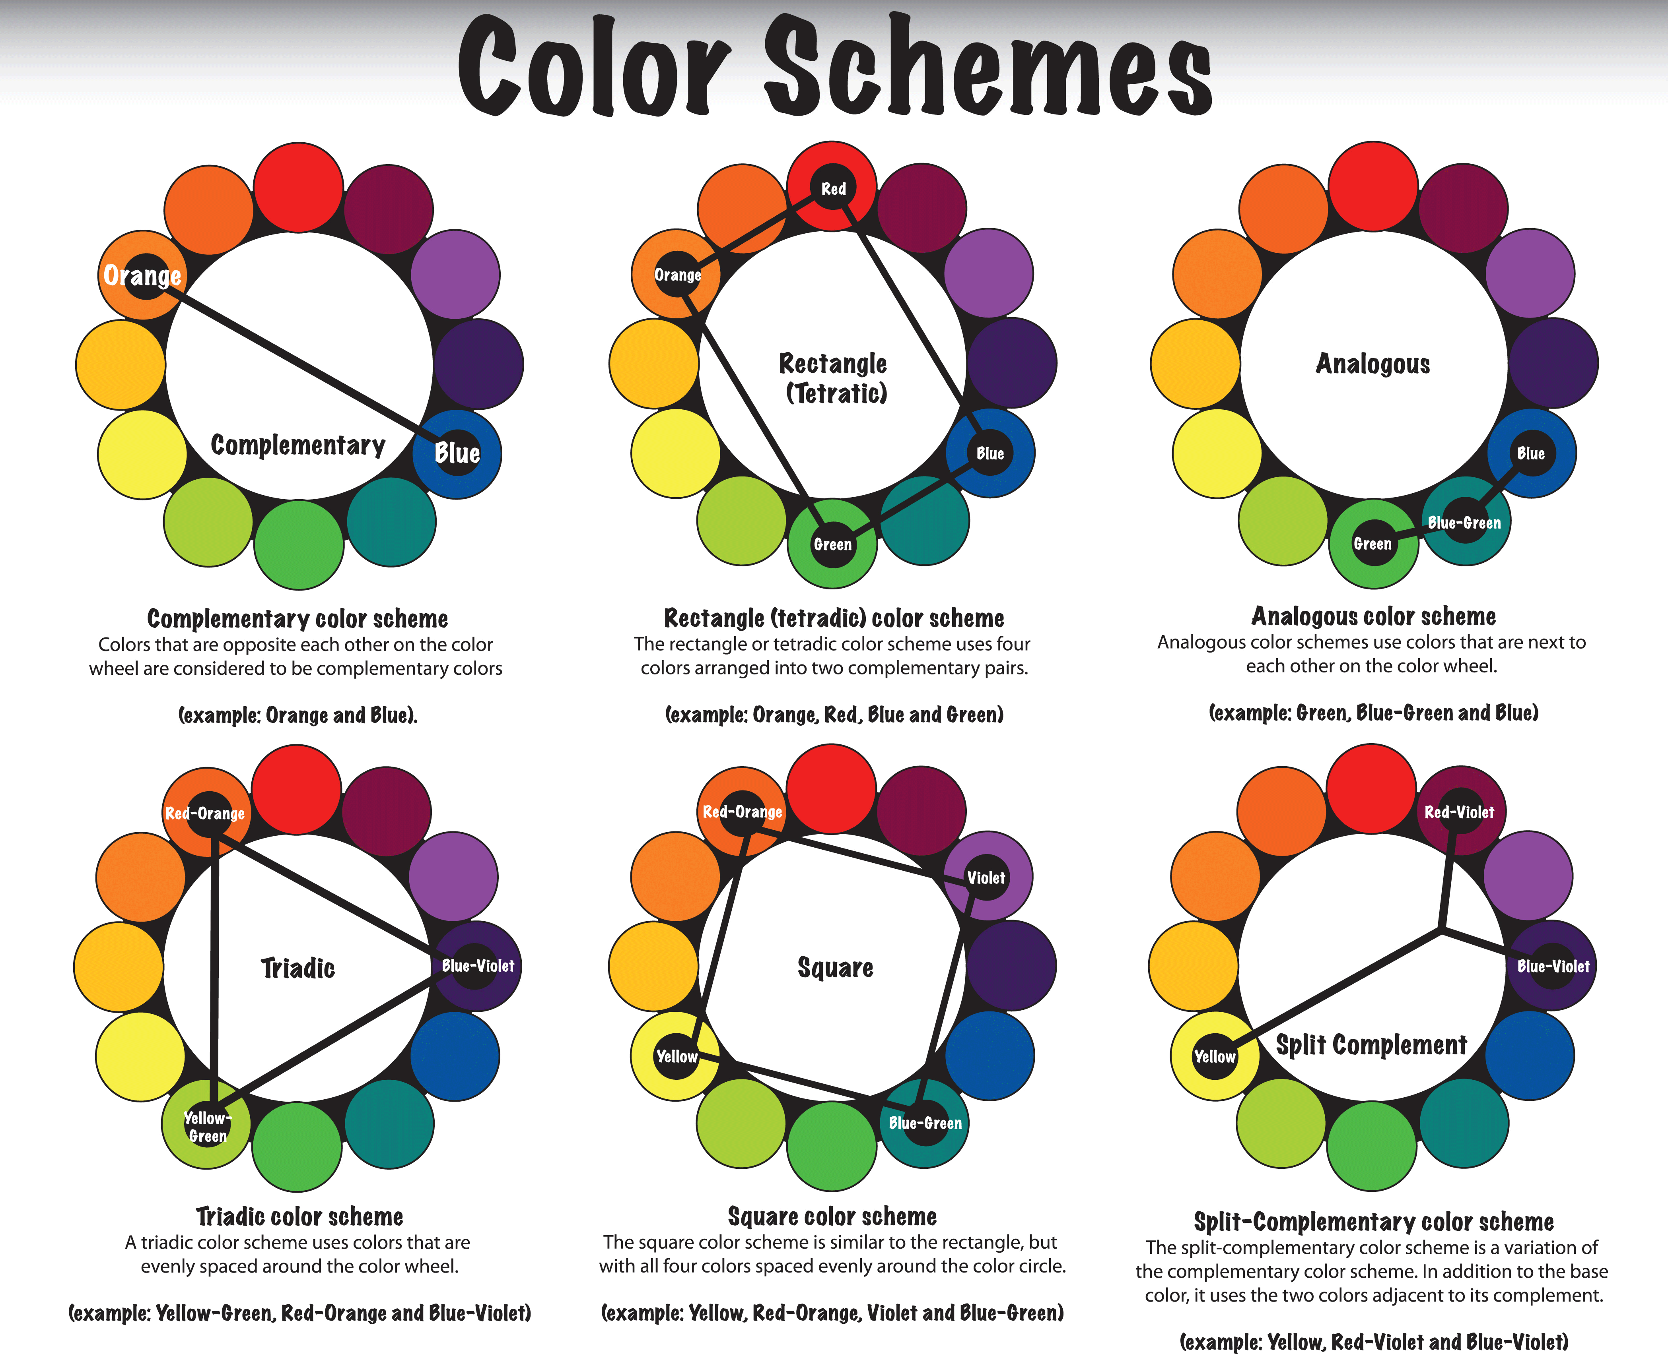

Research - Targeted
Demographic: Males, 10-13 (Schell)

Slide 5



Research – Mood Boards

Slide 6
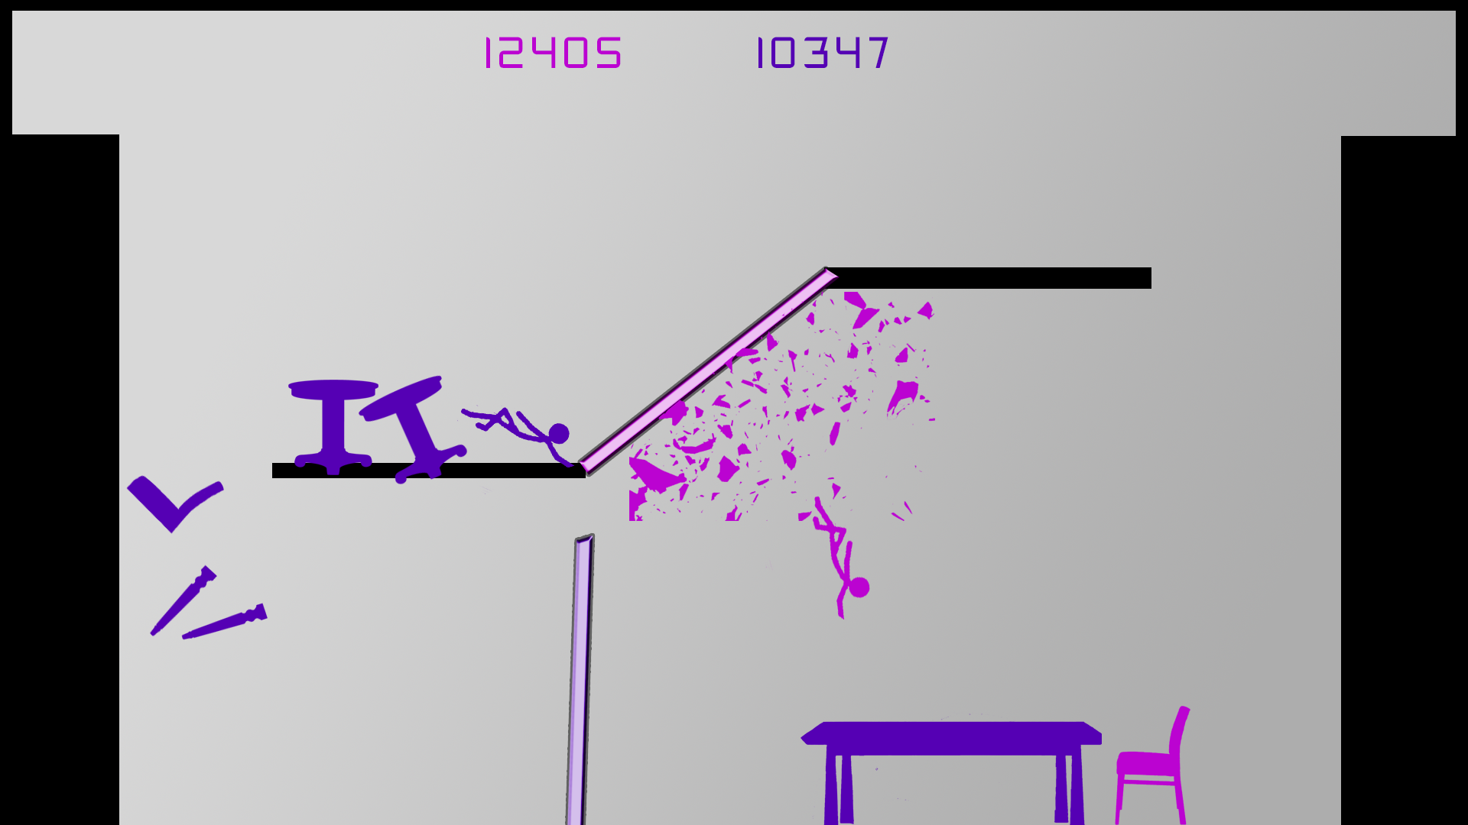
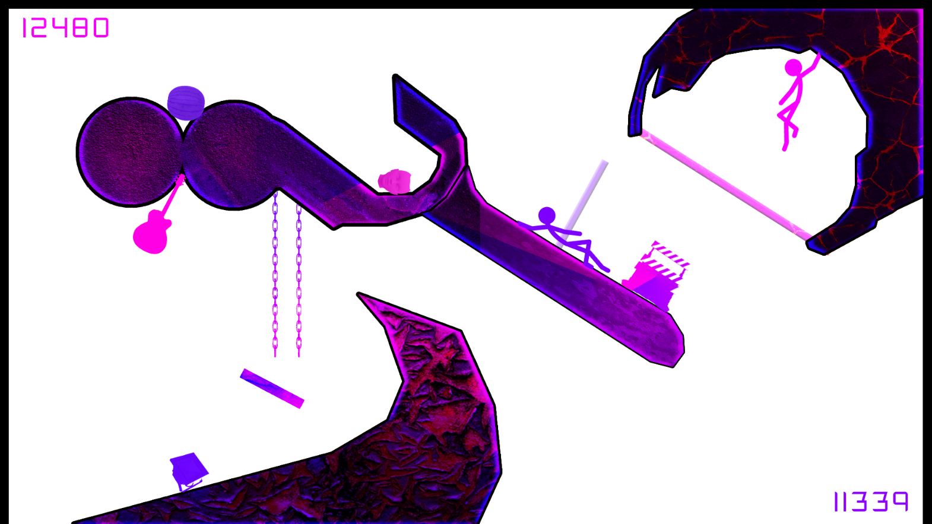
Our Game

Slide 7
Our Game – Cont.

